Slide 1
`Process` files:
Blueprints for Agentic AI
Llewellyn Falco

Slide 2

Resources
github.com/isidore/Talks/blob/master/AgenticAIAndProcessfiles.md
Notes:
https://github.com/isidore/Talks/blob/master/AgenticAIAndProcessfiles.md

Slide 3
Fixing a Bug
In approvaltests.go

Slide 4
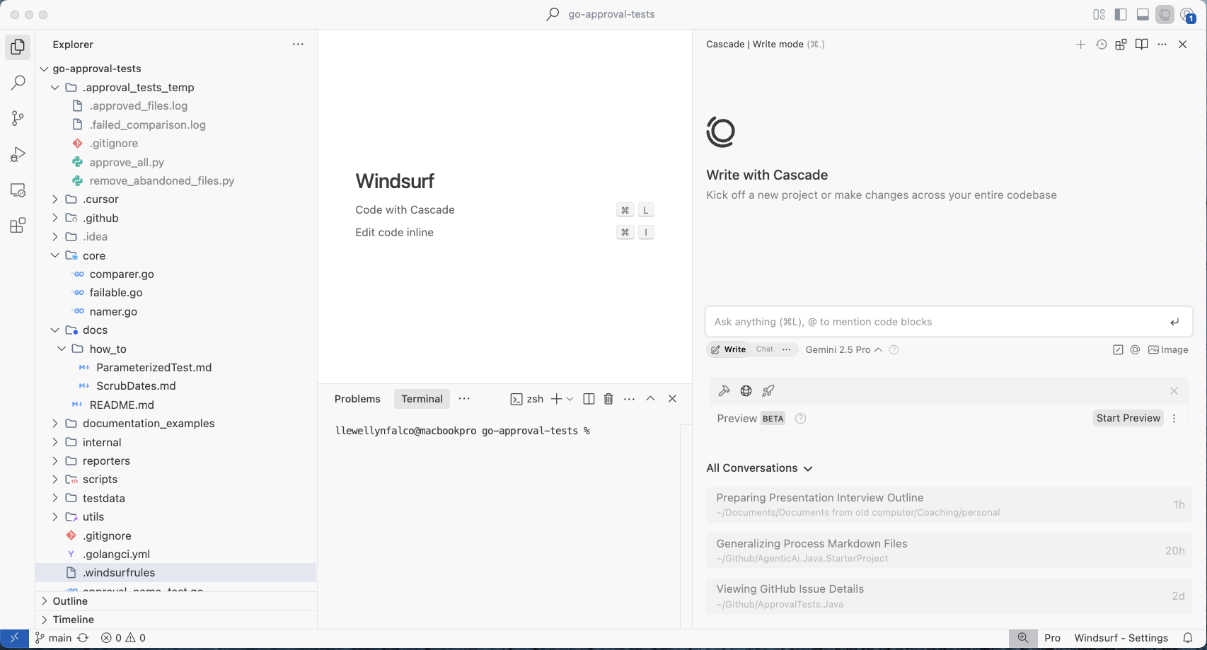

Slide 5
The AI can see your
whole system

Slide 6
The AI can see your
whole system (if it asks)

Slide 9
Let’s fix bug #49
What?
https://github.com/approvals/go-approval-tests/issues/49
…. Garbage ….

Slide 10
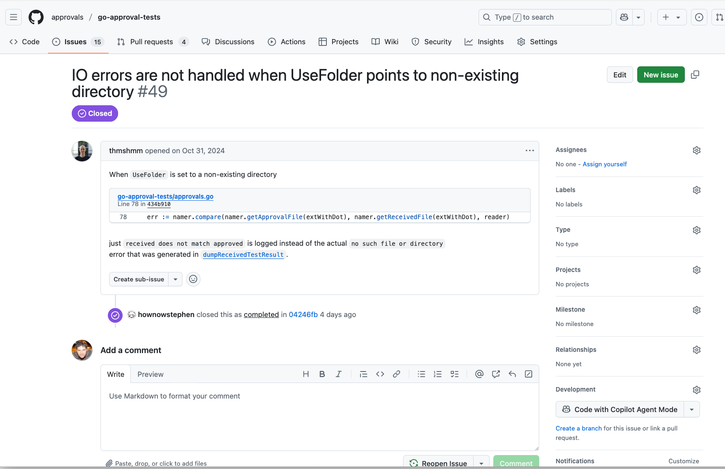

Slide 11
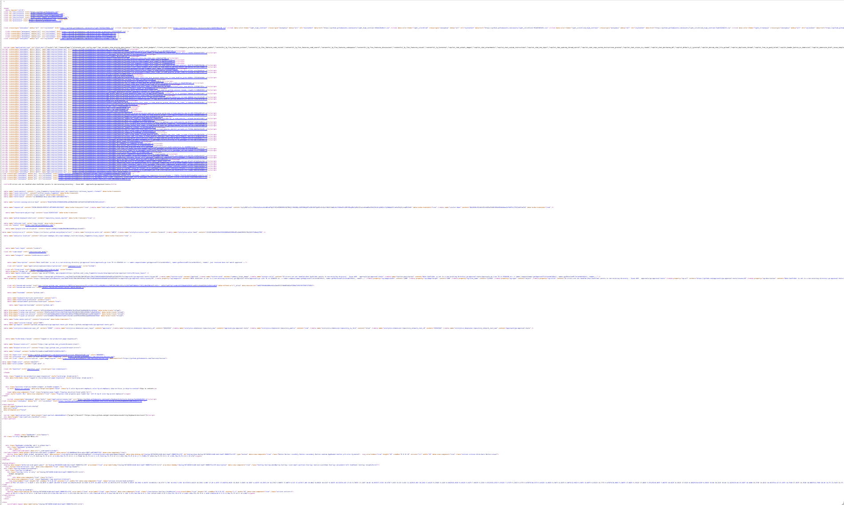

Slide 12
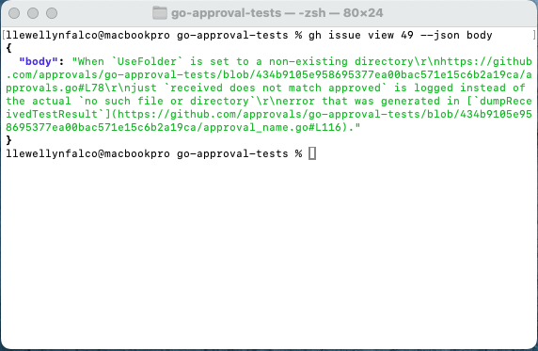

Slide 13

Let’s fix bug #49
What?
https://github.com/approvals/go-approval-tests/issues/49
…. Garbage ….
Use ‘gh issue view <number> --json body‘
Ok, should I make the code changes?
{ "body": "When `UseFolder` is set to a non-existing directory" + "\r\nhttps://github.com/approvals/go-approval-tests/blob/434b91" + "05e958695377ea00bac571e15c6b2a19ca/approvals.go#L78\r\n" + "just `received does not match approved` is logged instead " + "of the actual `no such file or directory`\r\nerror that was " + "generated in [`dumpReceivedTestResult`](https://github.com/appro" + "vals/go-approval-tests/blob/434b9105e958695377" + "ea00bac571e15c6b2a19ca/approval_name.go#L116).", }

Slide 14
It can use tools

Slide 15
It can use your tools

Slide 16

Ok, should I make the code changes?
No, first write a unit test to confirm the bug.
Ok, Done.
Run the tests.
Yes, it’s failing as expected
Great, Fix the code.
Ok, Done.
Did it work?
Yes, the tests pass now. Should I commit the code?
No, clean up the code, remove the comments.
Ok, Done.
And cleanup the names
Ok, Done.

Slide 17
Does it still work?
Tests still pass. Should I commit the code?
What’s the message?
Fixed directory creation
No, use `- B fixed #49 create directory when needed`
Ok, committed

Slide 18
That was cool… Let’s do it again

Slide 19
Please create `fixing_bugs.process.md` and write up the steps to fix bugs based on this conversation.
Ok

Slide 20
# Process for Fixing Bugs
Ask for the bug number. When fixing a bug reported in an issue:
1. **Understand the Bug**:
* Thoroughly read the issue description and any related comments to understand the problem, expected behavior, and actual behavior.
* Read the pull request via the github cli: `gh issue view <number> --json body`
2. **Write a Failing Test**:
* Create a new test case or modify an existing one in the relevant test suite
* The test should specifically target the scenario described in the bug report and fail with the current codebase, clearly demonstrating the bug (e.g., throwing the specific exception, producing incorrect output). * Run the tests to verify the bug
3. **Implement the Fix**:
* Modify the necessary source code file(s) to correct the bug.
* Focus on addressing the root cause identified by the failing test.
4. **Verify the Fix**:
* Run the tests
* Confirm that the previously failing test now passes.
* Ensure **all** other tests continue to pass, verifying no regressions were introduced.
5. **Refactor and Commit the Changes**:
* Remove unneeded comments, improve variable names and run tests to confirm refactorings. * Use the Arlo Commit Notation (`<Risk Symbol> B <Title>`). Typically, the risk symbol will be `-` (Tested) if you wrote a unit test.
* Reference the fixed issue number in the commit message body (e.g., `Fixes #<issue_number>`).

Slide 21
Please read `fixing_bugs.process.md` and follow the instructions.
Ok… what’s the bug number we are fixing today?

Slide 22
49
{ "body": "When `UseFolder` is set to a non-existing directory" + "\r\nhttps://github.com/approvals/go-approval-tests/blob/434b91" + "05e958695377ea00bac571e15c6b2a19ca/approvals.go#L78\r\n" + "just `received does not match approved` is logged instead " + "of the actual `no such file or directory`\r\nerror that was " + "generated in [`dumpReceivedTestResult`](https://github.com/appro" + "vals/go-approval-tests/blob/434b9105e958695377" + "ea00bac571e15c6b2a19ca/approval_name.go#L116).", }
Ok, Let me write a failing test.
Running…. 1 test failed.
The test confirms the bug. I’ll fix the code. All Test Passed The bug is fix, next I’ll refactor the code. Cleaned up the comments All Tests Passed Improved the names All Tests Passed Let’s commit the code. How about this message: `- B fixed #49 create directory when needed
y
Ok, committed

Slide 23
We used to automate processes

Slide 24
Now we can automate ourselves

Slide 25
?
Let’s code?…

Slide 26
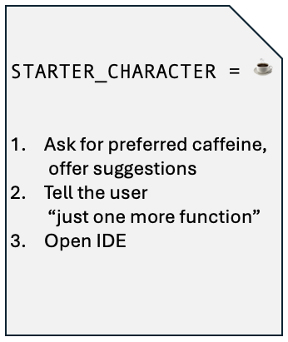
my.Process.md Files
>.windsurf/processes/
💻 BashScripts.process.md 🔴 TDD.creating_tests.process.md
🟢 TDD.implement_production.process.md
🟣 TDD.refactoring.process.md

Slide 27
#1.
#2.
#3.
#4.
#5.
#6.

Slide 28

“
Asking the LLM to do it just felt like... sitting at the drive-thru intercom
trying to make sure they got the "no meat" part,
and then pulling up to the second window and hoping the person slapping the sandwich together noticed that.
”
Sam Livingston-Gray

Slide 29
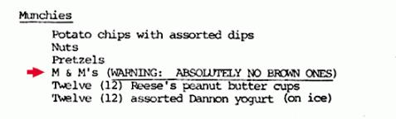
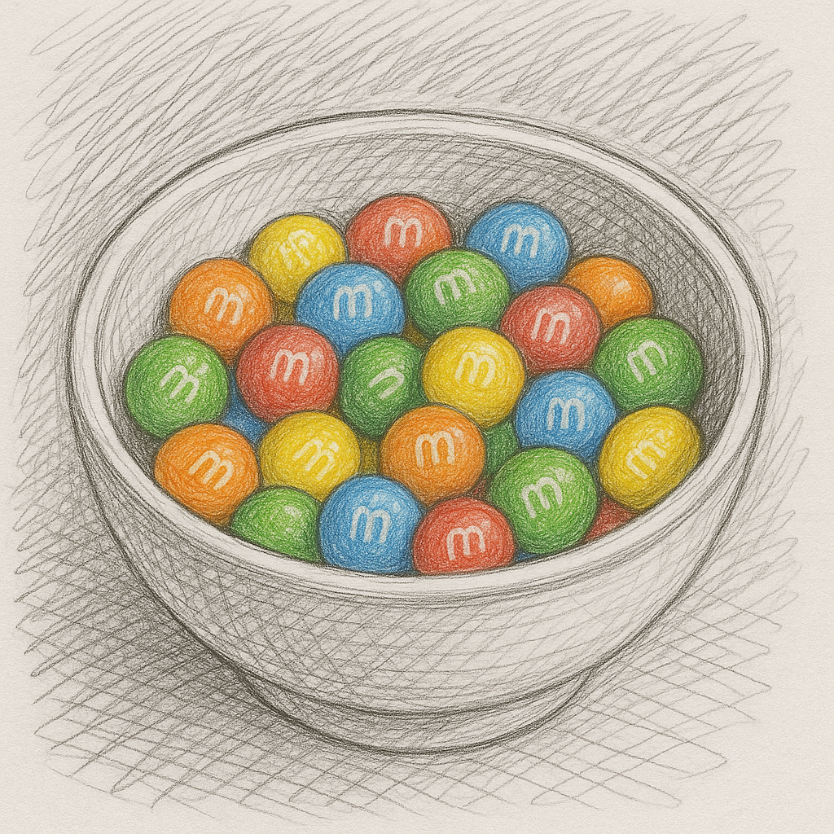

Canary clauses
and brown M&Ms

Slide 30
Canary clauses
rules.md
**ALWAYS** add the STARTER_CHARACTER followed by space at the start of your reply.
The STARTER_CHARACTER will change for each process file that is in progress.
Default STARTER_CHARACTER = 🧩
🧩 OK.

Slide 31

Context Window number of tokens the LLM can handle
Notes:
7000 + or - 2

Slide 32
Effective Context number of tokens before the responses start to significantly degrade
Notes:
7000 + or - 2

Slide 33
Effective Context number of tokens before the responses start to significantly degrade
Notes:
7000 + or - 2

Slide 34
my.Process.md Files
late_night_coding.process.md
STARTER_CHARACTER = ☕
Ask for preferred caffeine, offer suggestions
Tell the user “just one more function”
Open IDE
Please read @late_night_coding.process.md and follow the instructions
☕ How would you like your caffeine? (coffee, tea, soda, intravenous)

Slide 35
Please read @late_night_coding.process.md and follow the instructions
my.Process.md Files
🥤 How would you like your caffeine? (coffee, tea, soda, intravenous)
late_night_coding.process.md
STARTER_CHARACTER = 🥤
Ask for preferred caffeine, offer suggestions
Tell the user “just one more function”
Open IDE
Soda
🥤 Great, Just one more function to write before bed, are you ready?
yes
Let’s get started…

Slide 36



Components
of an Effective AI Prompt
Structured
Built
Impromptu
+
+
Data /
Context

Slide 37

Components
of an Effective AI Prompt
Structured
Built
Impromptu
Data /
Context
Human
in-the-loop
+
Data /
Context
Data /
Context
+
Data /
Context

Slide 38
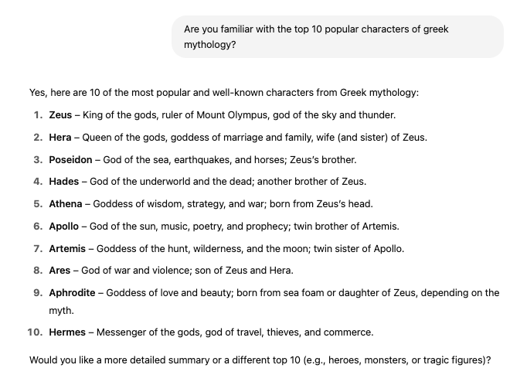
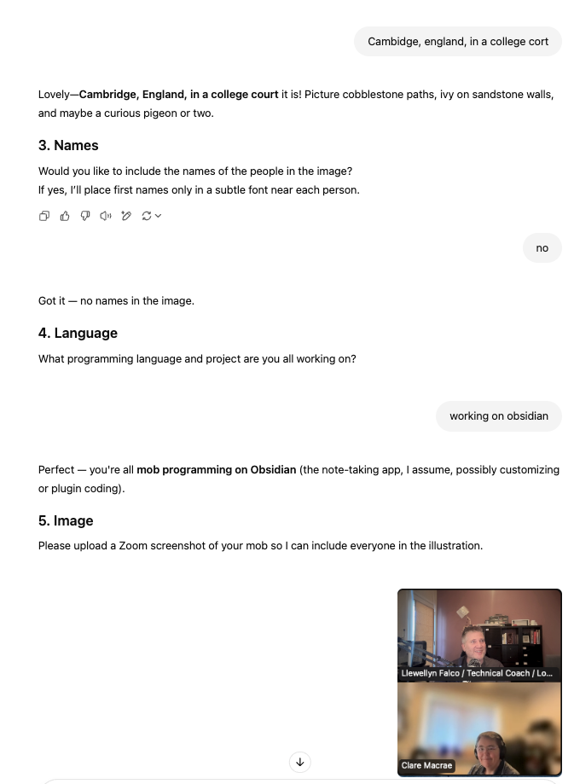
Human
in-the-loop
Pre-Heat
Interview me
Build a Doc
Diagram
Unit Test
Check List
✅ item 1
☐ item 2
☐ item 3

Slide 39



Actions
Structured
Built
Impromptu
A
Text
File Reads
+
+
Data /
Context
File Edits
Terminal
Commands

Slide 40
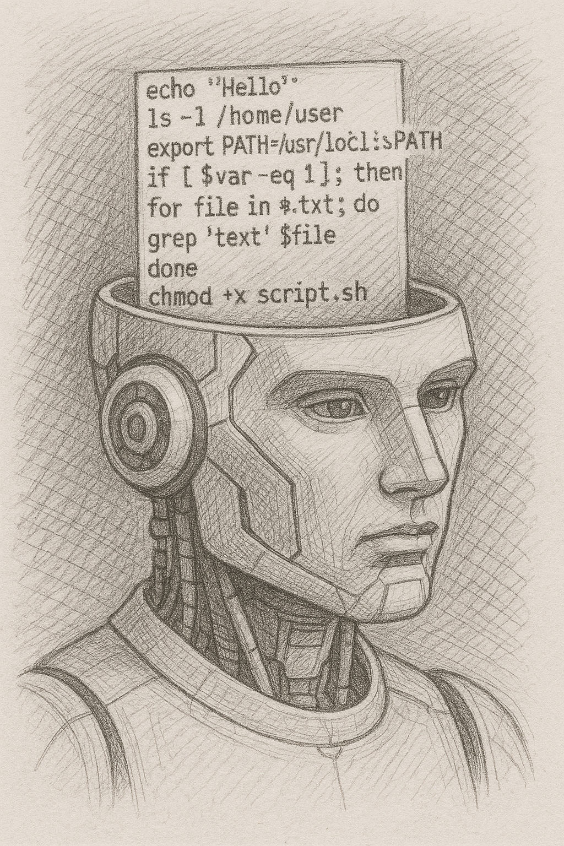
Actions
Terminal
Commands
AI fuzzy logic
Deterministic processes

Slide 41
Actions
Terminal
Commands
Deterministic processes
AI fuzzy logic

Slide 42
Actions
Run Tests
Terminal
Commands
-am,--also-make
-amd,--also-make-dependents
-B,--batch-mode
-b,--builder <arg>
-C,--strict-checksums
-c,--lax-checksums
--color <arg>
-cpu,--check-plugin-updates
-D,--define <arg>
-e,--errors
-emp,--encrypt-master-password <arg>
-ep,--encrypt-password <arg>
-f,--file <arg>
-fae,--fail-at-end
-ff,--fail-fast
-fn,--fail-never
-gs,--global-settings <arg>
-gt,--global-toolchains <arg>
-h,--help
-l,--log-file <arg>
-llr,--legacy-local-repository
-N,--non-recursive
-npr,--no-plugin-registry
-npu,--no-plugin-updates
-nsu,--no-snapshot-updates
-ntp,--no-transfer-progress
-o,--offline
-P,--activate-profiles <arg>
-pl,--projects <arg>
-q,--quiet
-rf,--resume-from <arg>
-s,--settings <arg>
-t,--toolchains <arg>
-T,--threads <arg>
-U,--update-snapshots
-up,--update-plugins
-v,--version
-V,--show-version
-X,--debug
clean
install test verify
mvn
Java
gradle

Slide 43
Actions
Run Tests
Terminal
Commands
rules.md
To run tests: `./build_and_test.sh`

Slide 44
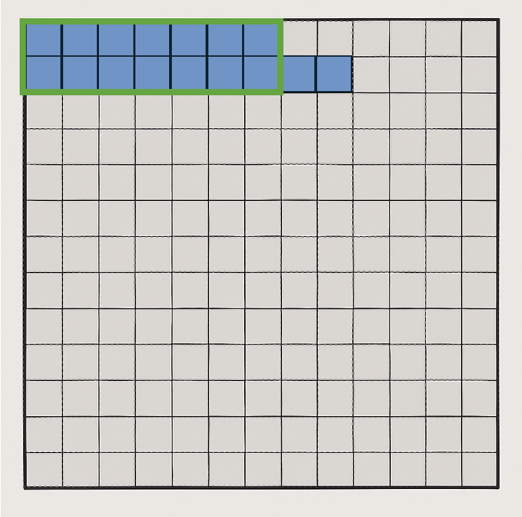
Actions
Feedback
Terminal
Commands
rule[INFO] Scanning for projects...
[INFO]
[INFO] --------------< starterproject:approvaltests_playground >---------------
[INFO] Building approvaltests_playground 1.0-SNAPSHOT
[INFO] --------------------------------[ jar ]---------------------------------
[INFO]
[INFO] --- maven-resources-plugin:2.6:resources (default-resources) @ approvaltests_playground ---
[WARNING] Using platform encoding (UTF-8 actually) to copy filtered resources, i.e. build is platform dependent!
[INFO] skip non existing resourceDirectory /Users/llewellynfalco/Github/AgenticAi.Java.StarterProject/src/main/resources
[INFO]
[INFO] --- maven-compiler-plugin:3.14.0:compile (default-compile) @ approvaltests_playground ---
[INFO] Nothing to compile - all classes are up to date.
[INFO]
[INFO] --- maven-resources-plugin:2.6:testResources (default-testResources) @ approvaltests_playground ---
[WARNING] Using platform encoding (UTF-8 actually) to copy filtered resources, i.e. build is platform dependent!
[INFO] skip non existing resourceDirectory /Users/llewellynfalco/Github/AgenticAi.Java.StarterProject/src/test/resources
[INFO]
[INFO] --- maven-compiler-plugin:3.14.0:testCompile (default-testCompile) @ approvaltests_playground ---
[INFO] Nothing to compile - all classes are up to date.
[INFO]
[INFO] --- maven-surefire-plugin:3.5.3:test (default-test) @ approvaltests_playground ---
[INFO] Using auto detected provider org.apache.maven.surefire.junitplatform.JUnitPlatformProvider
[INFO]
[INFO] -------------------------------------------------------
[INFO] T E S T S
[INFO] -------------------------------------------------------
[INFO] Running org.samples.SampleTests
[INFO] Tests run: 3, Failures: 0, Errors: 0, Skipped: 0, Time elapsed: 0.327 s -- in org.samples.SampleTests
[INFO] Running org.samples.HexBoardTest
[INFO] Tests run: 5, Failures: 0, Errors: 0, Skipped: 0, Time elapsed: 0.142 s -- in org.samples.HexBoardTest
[INFO]
[INFO] Results:
[INFO]
[INFO] Tests run: 8, Failures: 0, Errors: 0, Skipped: 0
[INFO]
[INFO]
[INFO] --- maven-jar-plugin:2.4:jar (default-jar) @ approvaltests_playground ---
[INFO] ------------------------------------------------------------------------
[INFO] BUILD SUCCESS
[INFO] ------------------------------------------------------------------------
[INFO] Total time: 3.489 s
[INFO] Finished at: 2025-05-20T05:09:25-06:00
[INFO] ------------------------------------------------------------------------s.md

Slide 45
Actions
mvn verify –-output=ai
Terminal
Commands
./build_and_test.sh
[INFO] Scanning for projects...
[INFO]
[INFO] --------------< starterproject:approvaltests_playground >---------------
[INFO] Building approvaltests_playground 1.0-SNAPSHOT
[INFO] --------------------------------[ jar ]---------------------------------
[INFO]
[INFO] --- maven-resources-plugin:2.6:resources (default-resources) @ approvaltests_playground ---
[WARNING] Using platform encoding (UTF-8 actually) to copy filtered resources, i.e. build is platform dependent!
[INFO] skip non existing resourceDirectory /Users/llewellynfalco/Github/AgenticAi.Java.StarterProject/src/main/resources
[INFO]
[INFO] --- maven-compiler-plugin:3.14.0:compile (default-compile) @ approvaltests_playground ---
[INFO] Nothing to compile - all classes are up to date.
[INFO]
[INFO] --- maven-resources-plugin:2.6:testResources (default-testResources) @ approvaltests_playground ---
[WARNING] Using platform encoding (UTF-8 actually) to copy filtered resources, i.e. build is platform dependent!
[INFO] skip non existing resourceDirectory /Users/llewellynfalco/Github/AgenticAi.Java.StarterProject/src/test/resources
[INFO]
[INFO] --- maven-compiler-plugin:3.14.0:testCompile (default-testCompile) @ approvaltests_playground ---
[INFO] Nothing to compile - all classes are up to date.
[INFO]
[INFO] --- maven-surefire-plugin:3.5.3:test (default-test) @ approvaltests_playground ---
[INFO] Using auto detected provider org.apache.maven.surefire.junitplatform.JUnitPlatformProvider
[INFO]
[INFO] -------------------------------------------------------
[INFO] T E S T S
[INFO] -------------------------------------------------------
[INFO] Running org.samples.SampleTests
[INFO] Tests run: 3, Failures: 0, Errors: 0, Skipped: 0, Time elapsed: 0.323 s -- in org.samples.SampleTests
[INFO] Running org.samples.HexBoardTest
[May 20, 2025, 5:23:45 AM ~000000ms] To approve run : mv -f /Users/llewellynfalco/Github/AgenticAi.Java.StarterProject/src/test/java/org/samples/HexBoardTest.create11x4HexBoard_andRenderAsciiArt.received.txt /Users/llewellynfalco/Github/AgenticAi.Java.StarterProject/src/test/java/org/samples/HexBoardTest.create11x4HexBoard_andRenderAsciiArt.approved.txt
[ERROR] Tests run: 5, Failures: 1, Errors: 0, Skipped: 0, Time elapsed: 0.228 s <<< FAILURE! -- in org.samples.HexBoardTest
[ERROR] org.samples.HexBoardTest.create11x4HexBoard_andRenderAsciiArt -- Time elapsed: 0.110 s <<< FAILURE!
org.opentest4j.AssertionFailedError:
expected: <Hexboard 11x4
( 0,0) ( 0,2) ( 0,4) ( 0,6)
( 1,1) ( 1,3) ( 1,5) ( 1,7)
( 2,0) ( 2,2) ( 2,4) ( 2,6)
( 3,1) ( 3,3) ( 3,5) ( 3,7)
( 4,0) ( 4,2) ( 4,4) ( 4,6)
( 5,1) ( 5,3) ( 5,5) ( 5,7)
( 6,0) ( 6,2) ( 6,4) ( 6,6)
( 7,1) ( 7,3) ( 7,5) ( 7,7)
( 8,0) ( 8,2) ( 8,4) ( 8,6)
( 9,1) ( 9,3) ( 9,5) ( 9,7)
(10,0) (10,2) (10,4) (10,6)
> but was: <Hexboard 10x4
(0,0) (0,2) (0,4) (0,6)
(1,1) (1,3) (1,5) (1,7)
(2,0) (2,2) (2,4) (2,6)
(3,1) (3,3) (3,5) (3,7)
(4,0) (4,2) (4,4) (4,6)
(5,1) (5,3) (5,5) (5,7)
(6,0) (6,2) (6,4) (6,6)
(7,1) (7,3) (7,5) (7,7)
(8,0) (8,2) (8,4) (8,6)
(9,1) (9,3) (9,5) (9,7)
>
at org.junit.jupiter.api.AssertionFailureBuilder.build(AssertionFailureBuilder.java:151)
at org.junit.jupiter.api.AssertionFailureBuilder.buildAndThrow(AssertionFailureBuilder.java:132)
at org.junit.jupiter.api.AssertEquals.failNotEqual(AssertEquals.java:197)
at org.junit.jupiter.api.AssertEquals.assertEquals(AssertEquals.java:182)
at org.junit.jupiter.api.AssertEquals.assertEquals(AssertEquals.java:177)
at org.junit.jupiter.api.Assertions.assertEquals(Assertions.java:1145)
at java.base/jdk.internal.reflect.DirectMethodHandleAccessor.invoke(DirectMethodHandleAccessor.java:104)
at java.base/java.lang.reflect.Method.invoke(Method.java:577)
at org.approvaltests.reporters.AbstractJUnitReporter.assertEquals(AbstractJUnitReporter.java:25)
at org.approvaltests.reporters.AbstractJUnitReporter.report(AbstractJUnitReporter.java:45)
at org.approvaltests.reporters.FirstWorkingReporter.report(FirstWorkingReporter.java:23)
at org.approvaltests.approvers.FileApprover.reportFailure(FileApprover.java:68)
at org.approvaltests.Approvals.verify(Approvals.java:234)
at org.approvaltests.Approvals.verify(Approvals.java:188)
at org.approvaltests.Approvals.verify(Approvals.java:196)
at org.approvaltests.Approvals.verify(Approvals.java:55)
at org.approvaltests.Approvals.verify(Approvals.java:64)
at org.approvaltests.Approvals.verify(Approvals.java:59)
at org.samples.HexBoardTest.create11x4HexBoard_andRenderAsciiArt(HexBoardTest.java:28)
at java.base/java.lang.reflect.Method.invoke(Method.java:577)
at java.base/java.util.ArrayList.forEach(ArrayList.java:1511)
at java.base/java.util.ArrayList.forEach(ArrayList.java:1511)
[INFO]
[INFO] Results:
[INFO]
[ERROR] Failures:
[ERROR] HexBoardTest.create11x4HexBoard_andRenderAsciiArt:28 expected: <Hexboard 11x4
( 0,0) ( 0,2) ( 0,4) ( 0,6)
( 1,1) ( 1,3) ( 1,5) ( 1,7)
( 2,0) ( 2,2) ( 2,4) ( 2,6)
( 3,1) ( 3,3) ( 3,5) ( 3,7)
( 4,0) ( 4,2) ( 4,4) ( 4,6)
( 5,1) ( 5,3) ( 5,5) ( 5,7)
( 6,0) ( 6,2) ( 6,4) ( 6,6)
( 7,1) ( 7,3) ( 7,5) ( 7,7)
( 8,0) ( 8,2) ( 8,4) ( 8,6)
( 9,1) ( 9,3) ( 9,5) ( 9,7)
(10,0) (10,2) (10,4) (10,6)
> but was: <Hexboard 10x4
(0,0) (0,2) (0,4) (0,6)
(1,1) (1,3) (1,5) (1,7)
(2,0) (2,2) (2,4) (2,6)
(3,1) (3,3) (3,5) (3,7)
(4,0) (4,2) (4,4) (4,6)
(5,1) (5,3) (5,5) (5,7)
(6,0) (6,2) (6,4) (6,6)
(7,1) (7,3) (7,5) (7,7)
(8,0) (8,2) (8,4) (8,6)
(9,1) (9,3) (9,5) (9,7)
>
[INFO]
[ERROR] Tests run: 8, Failures: 1, Errors: 0, Skipped: 0
[INFO]
[INFO] ------------------------------------------------------------------------
[INFO] BUILD FAILURE
[INFO] ------------------------------------------------------------------------
[INFO] Total time: 3.411 s
[INFO] Finished at: 2025-05-20T05:23:45-06:00
[INFO] ------------------------------------------------------------------------
[ERROR] Failed to execute goal org.apache.maven.plugins:maven-surefire-plugin:3.5.3:test (default-test) on project approvaltests_playground: There are test failures.
[ERROR]
[ERROR] See /Users/llewellynfalco/Github/AgenticAi.Java.StarterProject/target/surefire-reports for the individual test results.
[ERROR] See dump files (if any exist) [date].dump, [date]-jvmRun[N].dump and [date].dumpstream.
[ERROR] -> [Help 1]
[ERROR]
[ERROR] To see the full stack trace of the errors, re-run Maven with the -e switch.
[ERROR] Re-run Maven using the -X switch to enable full debug logging.
[ERROR]
[ERROR] For more information about the errors and possible solutions, please read the following articles:
[ERROR] [Help 1] http://cwiki.apache.org/confluence/display/MAVEN/MojoFailureException
❌ Build failed.
./build_and_test.sh
✅ Built: 8 tests passed.

Slide 46
my.Process.md Files
late_night_coding.process.md
Windsurf → Workflows
Copilot → Instructions
Cursor → Rules

Slide 47
my.Process.md Files
late_night_coding.process.md
Windsurf → Workflows
Copilot → Instructions
Cursor → Rules

Slide 48
Trained for Agentic
Reinforcement Learning Step
Claude 3.5+
Chat GPT 4.1
Google Gemini 2.5 Pro
SWE-1

Slide 49
Components
of an Effective AI Prompt
Structured
Built
Impromptu
Data /
Context
Human
in-the-loop
+
Data /
Context
Data /
Context
+
Data /
Context

Slide 50

Thank You!
Please connect on LinkedIn
Llewellyn Falco
github.com/isidore/Talks/blob/master/AgenticAIAndProcessfiles.md
Notes:
https://github.com/isidore/Talks/blob/master/AgenticAIAndProcessfiles.md

Slide 51
Notes:
7000 + or - 2

